Slide 1
Terry traffic stops project
Cynthia Sophie Wangui Mwangi

Slide 2
Overview
The main aim of this project is to find out if unreasonable search and seizure of an individual by a police officer is justified.

Slide 3
Project walkthrough summary
Data
The data was sourced from the Seattle Police department
Goal
Utilize the data to predict if an arrest is made as a final resolution to the Terry Stop.
stakeholder
This project was conducted in light of and should be presented to the Court of Ohio
Model
The Model that whose results are being considered is the Random Forest model.

Slide 4
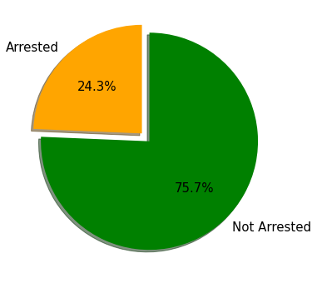
Analysis results Visualized
Ratio of those arrested vs those not arrested

Slide 5
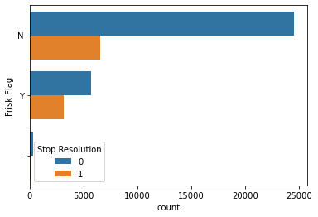
Analysis results Visualized
Did a Frisk lead to an arrest?
Less arrests are made after a frisk, less people are frisked after being stopped

Slide 6
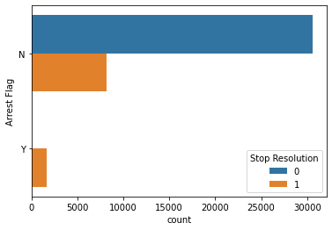
Analysis results Visualized
Will the arrest be made immediately after the stop or later
The is always going to be an arrest later after the Terry stop rather than immediately on the stop

Slide 7
Recommendation
Train officers on when is an appropriate time to arrest someone during the terry stop vs. when it is appropriate to wait until later as this is another key indicator of arrests

Slide 8
THANK YOU

